Slide 1
COMP 3111 Project
Group member : Wang Ding, Zeng Xiong, Zhang Tian,
Yang Ji, TAM Shih Lung

Slide 2



Slide 3

Where ?
2. how to get there?
3.How long can I get there?

Slide 4






Slide 5
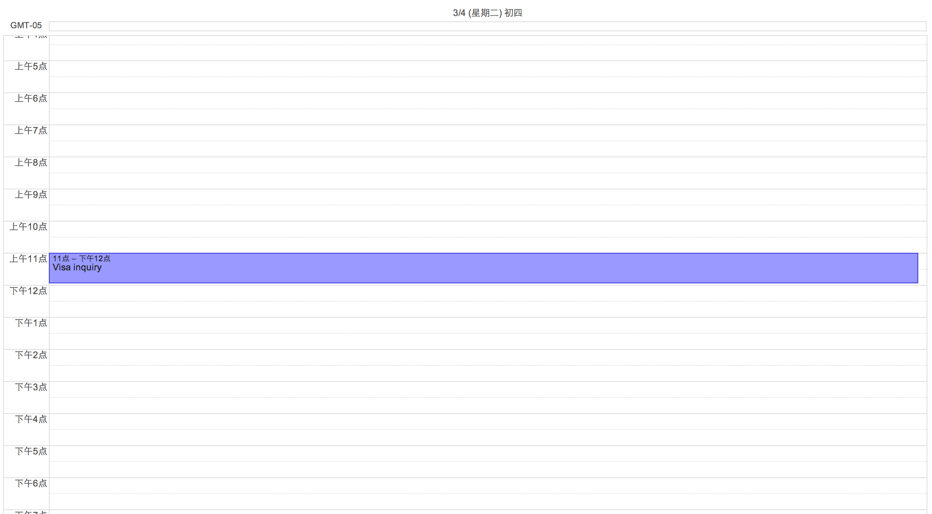
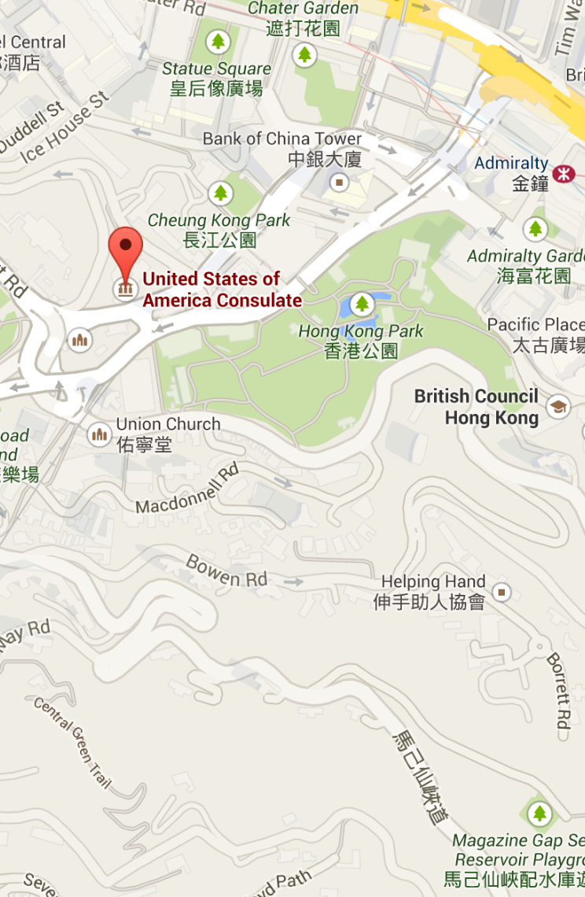
Date: March.4th
Time: 11:00am
Event: Visa Enquiry

